Slide 1
Fall Presentation 2025

Slide 2
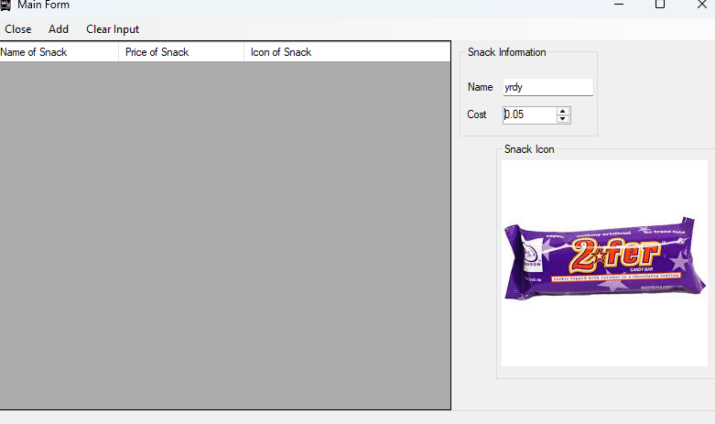
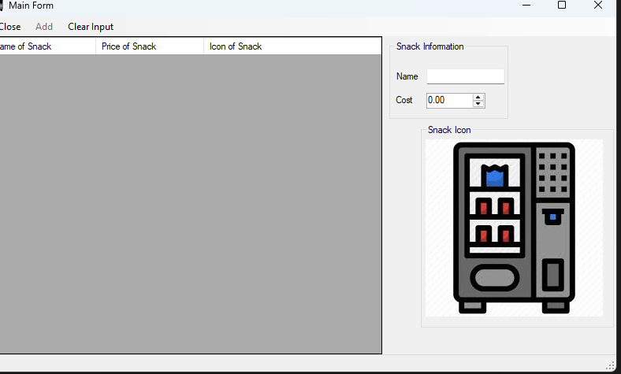
Tech
I worked on a “snack shack app”
The most difficult part would have to be managing time for it… hence it’s lack of completion
However, that leads to my favorite part, which was all the stuff I utilized
Skills-wise, mostly logic and reasoning

Slide 3
Core
Well, for skills/ concepts, mostly just what we are good at and such.
In that vein, it’s useful at home and at work for the same reason; it helps you know what you can do

Slide 4
Favorite Memory
It’s hard to choose, so I’ll say clubs
Microwave meals was quite fun, because, you know, cooking
Magic the gathering was also quite fun, just due to playing games with friends

Slide 5
And now….
The meaning of life…

